Slide 1
Stack Operations

Slide 2
Stack
A LIFO (Last In First Out) data structure ▪ New value is added to the top of stack
▪ Existing values are removed from the top of stack
▪ An essential part of calling from and returning to the procedures
▪ Real life example
▪ A stack of plates

Slide 3
Runtime Stack (1/3)
▪ A memory array managed by CPU using ESP/SP (Extended Stack Pointer) register and SS (Stack Segment)
▪ ESP/SP always points to the last value pushed on the top of stack and holds offset of that value in Stack Segment
▪ ESP/SP cannot be manipulated directly instead it can be modified indirectly by instructions such as PUSH, POP, CALL, RET

Slide 4
Runtime Stack (2/3)
▪ In protected mode i.e. 32-bit mode, size of each stack location is 32-bits
▪ In real-address mode i.e. 16-bit mode, size of each stack location is 16-bits
▪ emu8086 uses real-address mode
▪ Runtime Stack is different from Stack Abstract Data Type which is typically written in a HLL

Slide 5
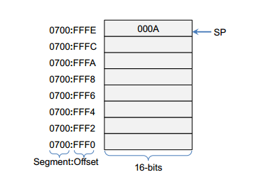
Runtime Stack (3/3)
▪ SS contains the base address of Stack Segment
▪ SP contains the offset of value at the top of stack

Slide 6
Push Operation (1/3)
▪ A push operation in stack puts the value on the top location available in stack and decrements the stack pointer by size of stack element
▪ Size of each stack element is 32 bits in protected address mode
▪ Size of each stack element is 16 bits in real address mode

Slide 7
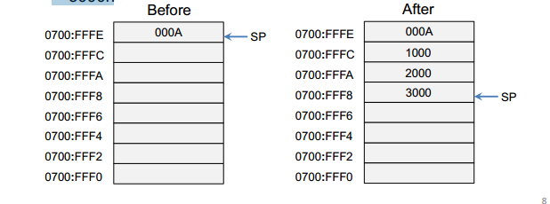
Push Operation (2/3)
▪ SP is decremented by 2 with each push operation
▪ These values are pushed on stack
▪ 1000h ▪ 2000h ▪ 3000h

Slide 8
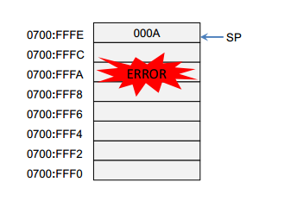
Push Operation (3/3)
▪ This value is pushed on stack 1 000 0000h

Slide 9
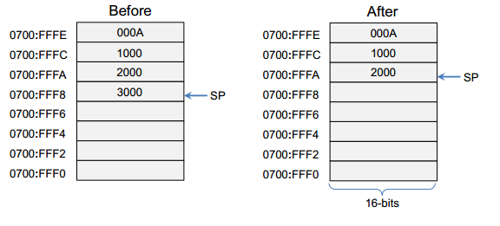
Pop Operation
▪ Removes value from top of stack
▪ SP is incremented by stack element size with each pop operation

Slide 10
PUSH Instruction
▪ PUSH instruction is executed in two steps
▪ First decrements SP by the size of stack element
▪ Then copies the source operand on top of stack
▪ PUSH instruction formats
▪ PUSH reg/mem16 contents of 16-bit register or 16-bit memory location is pushed on stack
▪ PUSH imm16 16-bit immediate value is pushed on stack ▪ Examples are ▪ PUSH AX ▪ PUSH 10h

Slide 11
POP Instruction ▪ POP instruction is executed in two steps
▪ First the contents of stack element pointed to by SP are copied into destination operand
▪ Then SP is incremented by the size of stack element
▪ Only one POP instruction formats
▪ POP reg/mem16 copies the value pointed to by SP into 16-bit register or 16-bit memory location
▪ Examples are ▪ POP AX ▪ POP var ;where var is a 16-bit memory location

Slide 12
PUSHF and POPF Instructions ▪ PUSHF is used to push EFLAGS register on the stack
▪ POPF pops the stack into EFLAGS register
▪ When using these instructions, make sure program’s execution path does not skip over POPF instruction
▪ Syntax is ▪ PUSHF ▪ POPF

Slide 13
PUSHA and POPA Instructions
▪ PUSHA instruction pushes all 16-bit general purpose register on the stack in given order
▪ AX, CX, DX, BX, SP, BP, SI, DI
▪ POPA instruction pops the same registers in the reverse order
▪ Useful when modifying many general purpose registers inside a procedure

Slide 14
Stack Applications
▪ Registers can be saved temporarily when used for more than one purpose
▪ When CALL instruction executed, return address is saved on the stack
▪ Arguments are passed to a subroutine by pushing them on the stack
▪ Stack can be used as temporary storage for local variables inside a subroutine

Slide 15
LECTURE 2

Slide 16
Defining and Using Procedures
▪ Creating a Procedure
▪ CALL and RET instructions
▪ Nested Procedure Calls
▪ Local and Global Labels
▪ Procedure Parameters
▪ USES Operator

Slide 17
Procedure
▪ A complex code can be divided in different independent elements
▪ Such elements are called functions in C++ and Procedures in assembly language
▪ Procedure is a named block of statements that ends with a return statement

Slide 18
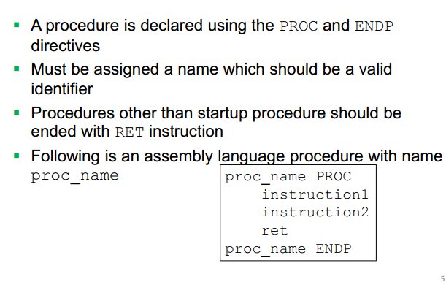
Creating a Procedure

Slide 19
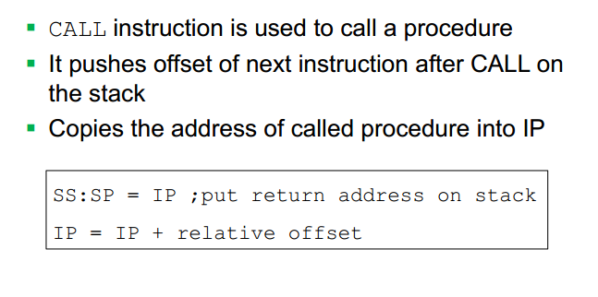
CALL Instruction

Slide 20
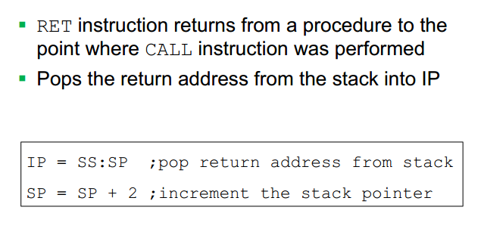
RET Instruction

Slide 21
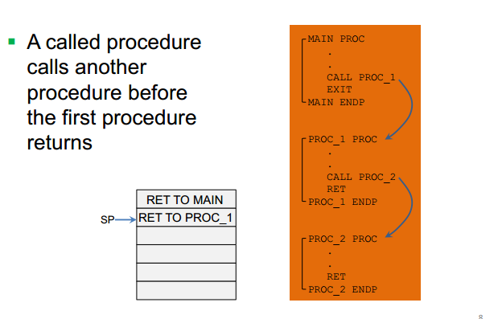
Nested Procedure Call

Slide 22
Parameter Passing in Procedures
▪ Parameter passing is different and complicated in assembly than in HLL
▪ In assembly language
▪ First place all required parameters in a mutually accessible storage area
▪ Then call the procedure
▪ Types of storage area are
▪ Registers (general purpose registers are used)
▪ Memory (Stack is used)
▪ Two common methods for parameter passing ▪ Register Method ▪ Stack Method

Slide 23
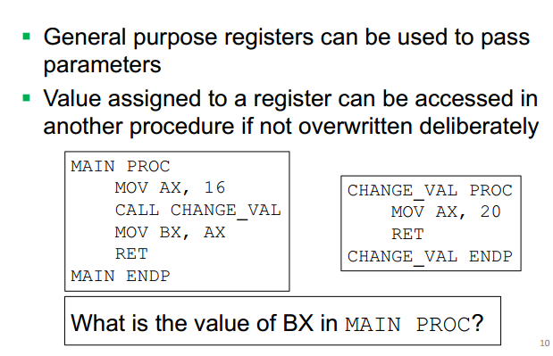
Parameter passing through registers

Slide 24
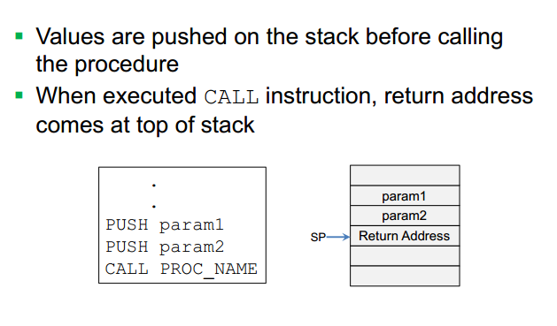
Parameters passing using STACK

Slide 25
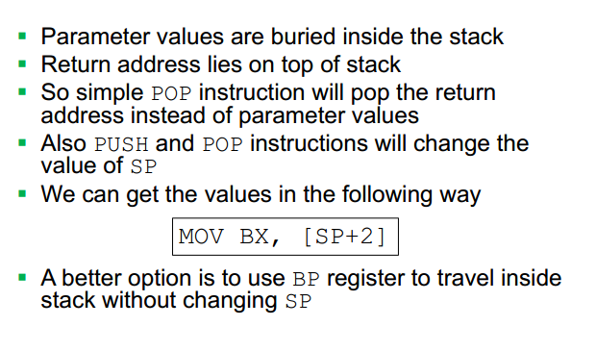

Slide 26
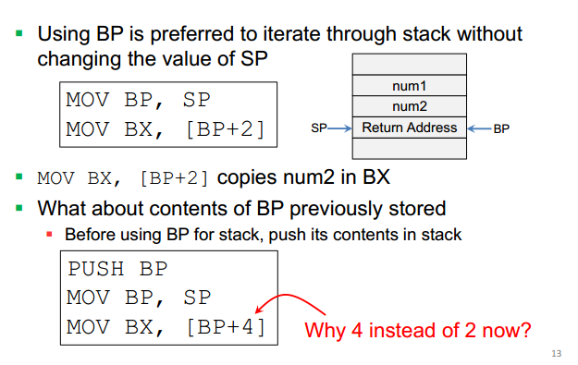
Using BP to travel inside STACK

Slide 27
USES Operator
▪ All registers modified in a procedure should be saved on stack and restored before return
▪ USES operator facilitates the saving and restoring of registers in an easy way
▪ USES operator is used right after PROC directive and lists names of all registers modified inside procedure

Slide 28
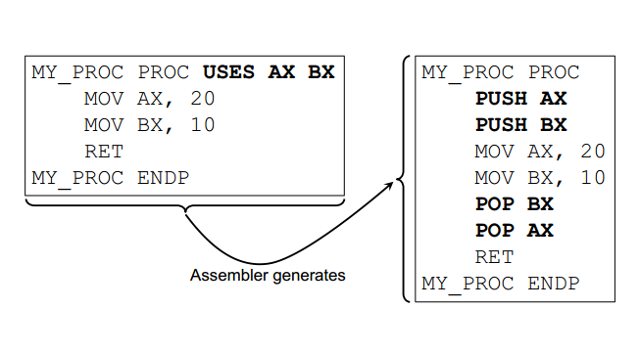

Slide 29
THANKS!
Any questions?
You can find me at:
A.qadeer@nu.edu.pk
Office #213, Visiting Hours Only

